Slide 1

Software Engineering
Test Driven Development
Harald Drillenburg
Year 2 2nd term

Slide 2
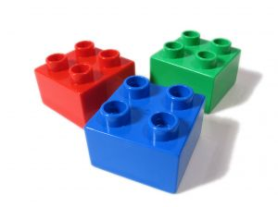
Course structure
Principles of Software Engineering
The zen of project planning
Developing under architecture
Designing with patterns
Testing and continuous integration
Test Driven Development
Architecture in Agile projects
Year 2 2nd term

Slide 3



Questions during class!
Jaar 2 Kwartaal 1

Slide 4
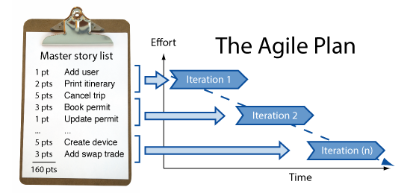

Discussion: project plan for EPD
Year 2 2nd term

Slide 5
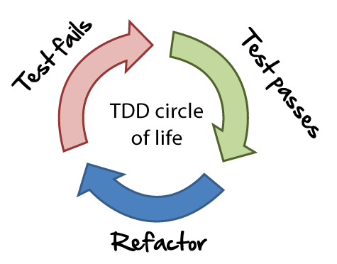
Main principles of TDD
Test first, not last
  So yes, you test before there’s something to test!
Implement the simplest code possible
Refactor to make designing tests easier
Year 2 2nd term

Slide 6

Example – Starbuzz Gift Cards
Coffee company StarBuzz – known from Design Patterns and OOP2 – is implementing Gift Cards functionality.
One functionality envisioned: Preorder your coffee with a gift card
Year 2 2nd term

Slide 7

Exercise – Starbuzz Gift Cards
Write the user story for the feature ‘Preorder your coffee with a gift card’
Year 2 2nd term

Slide 8
Exercise – Starbuzz Gift Cards
‘Preorder your coffee with a gift card’
Select your coffee preferences from the options, enter
your gift card number, name, preferred store, and click
submit to get a confirmation number, remaining
balance, and estimated time when you can pickup your
beverage.
Now define the three tasks involved.
Year 2 2nd term

Slide 9

Exercise – Starbuzz Gift Cards
‘Preorder your coffee with a gift card’
Capture order info, gift card info and receipt info
Implement business logic to process and store orders
Connect order processor to website
Year 2 2nd term

Slide 10
Define the test first
public class TestOrderInformation {
@Test
public void testCreateOrderInformation() {
OrderInformation orderInfo = new OrderInformation();
}
Year 2 2nd term

Slide 11
But this will fail miserably!
So what? That’s the whole point of TDD!
  Well, ok, not the whole point, but it sure is important
Rule #1: your test should always fail before you implement the code
Year 2 2nd term

Slide 12

Coffee Time
Year 2 2nd term

Slide 13
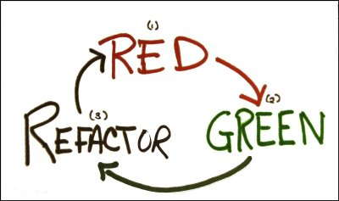
Red, Green, Refactor
Year 2 2nd term

Slide 14

Exercise – Starbuzz Gift Cards
Define the next tests and write the code
Year 2 2nd term

Slide 15

Tests DRIVE the implementation
Each test should only test ONE thing
Avoid duplicate test code
  Use annotations like @Before and @After
Keep your tests in mirror directories of your application code
Year 2 2nd term

Slide 16
Common misconceptions
Ah, so we don’t need to design the architecture anymore?
  Yes, you do. But TDD augments the architecture by:
    Enforcing regular refactoring
    Making you think about the interfaces
Can’t I just write the application code together with the tests?
  Well, you could. But it’s a slippery road. You can’t be certain you actually test what you think you do
Year 2 2nd term

Slide 17
Exercise - dependecies
The application needs a database to function
Testing with a database is hard, as it becomes unclear what’s actually causing failures
This also applies to other dependencies, both internal and external
Assignment: figure out how to evade this complication (if at all possible)
Year 2 2nd term

Slide 18
Adjust the design to testing
To solve this problem, we need to be able to mimick a database.
But doesn’t that introduce a lot of ‘if production do A, else if test A do B, else if…’ code?
How to solve this?
Year 2 2nd term

Slide 19
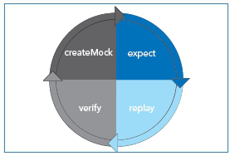
Use patterns to simplify testing
Use a Strategy Pattern to choose between the ‘real’ database and a mockup
Use a Factory Pattern to fake objects with specific behaviour
  These are called Mock Objects (yes, another pattern found!)
Year 2 2nd term

Slide 20

Testing IS difficult
But much more tools exist to make the life of the software engineer easier
Example: EasyMock
Year 2 2nd term

Slide 21

Homework
Read Chapter 8 from the textbook
Do the exercises intermingled in the book
Finish the exercises from the powerpoint sheets
Feed me more potential exam questions!
Year 2 2nd term

